Slide 1


BANK TELEMARKETING CAMPAIGN
PRESENTATION
By Avinash Pawar

Slide 2
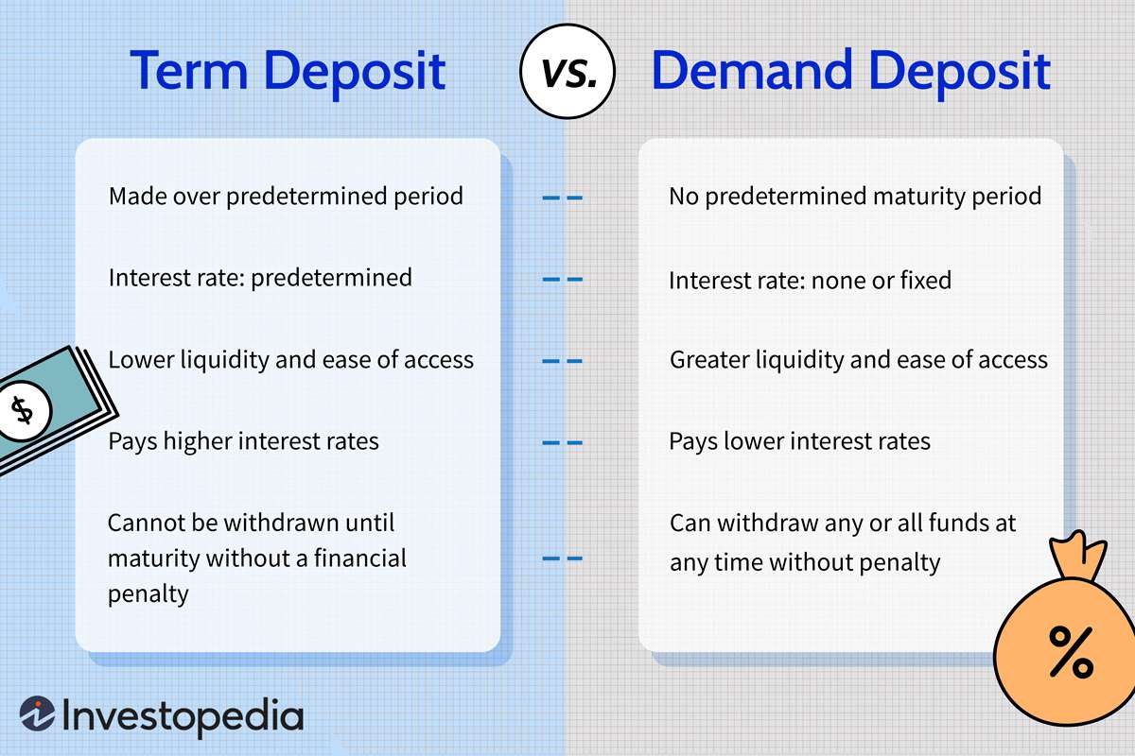
BUSINESS UNDERSTANDING
Business Problem – “Increase the positive response rate for term deposit campaigns among existing customers through data-driven insides and targeted marketing strategies.”
Understanding term deposit and its benefits for banks and customer – “In the business understanding phase, efforts were made to gain insights into the concept of term deposits and their significance for both banks and customers.”
Objectives – “Increase the positive response rate of term deposit campaigns, Improve the effectiveness of telemarketing efforts to encourage more customers to subscribe to term deposits. Identify customer demographics and preferences, Optimize marketing strategies, Enhance customer relationship management, Maximize revenue generation.”
Expected Outcomes: “The expected outcome for this project is to improve the effectiveness of term deposit campaigns through data-driven insights, resulting in increased customer subscriptions, enhanced customer relationships, and maximize revenue generation for the bank.”

Slide 3

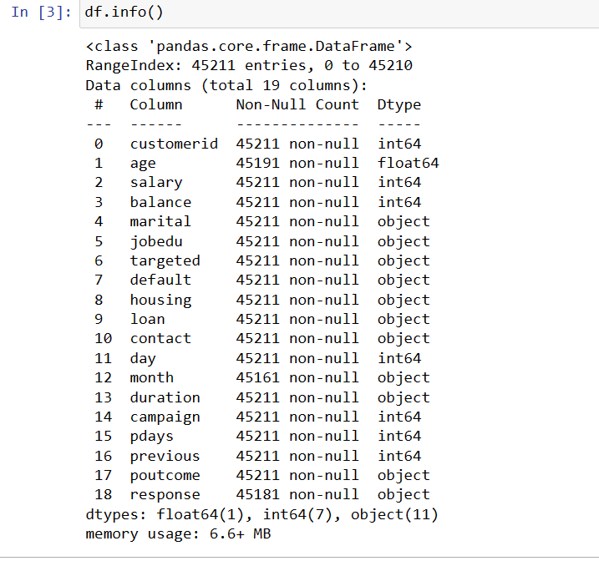
DATA UNDERSTANDING
1. Understanding the Dataset -
Collecting initial data - Received Bank term deposit data in CSV format along with attribute details and any accompanying questionnaire or objectives.
Data Overview - Dataset Size: 45,211 records, Attributes: 18 columns, Object Data Type: 11 columns, Integer Data Type: 7 columns, Float Data Type: 1 column
Data Quality Assessment -
Missing Values - "Missing values were found in the 'age' attribute (20 records), 'month' attribute (50 records), 'response' attribute (30 records), and 'year' attribute (50 records). All other attributes have no missing values.“
2. Outliers - "Outliers are present in the following columns: Age, Balance, Campaign, Pdays, Previous, and Duration_min. Conversely, no outliers were detected in the Salary and Day columns.“
3. Data inconsistencies - "Inconsistencies were observed in the dataset, including:
Variations in marital status, contact methods, and campaign outcomes.
Missing values in the 'month' and 'response' columns.
Potential data entry errors or anomalies in the 'age' column."

Slide 4


DATA PREPERATION
1. Data Preparation Phase-
Handling Missing Values- "Missing values in numerical columns (e.g., age) were imputed using median imputation, while missing values in categorical columns (e.g., month, response, year) were imputed using mode imputation, to maintain data integrity and preserve central tendencies in the dataset.“
2. Outliers -
“In the Data Preparation phase, outliers in columns such as age, balance, campaign, pdays, previous, and duration_min were effectively managed using the Interquartile Range (IQR) method. .“
3. Data inconsistencies –
“Data inconsistencies were addressed through resolving variations in categorical data such as marital status, contact methods, and campaign outcomes, as well as handling missing values in the 'month' and 'response' columns to ensure dataset coherence and reliability for analysis."
4. Data Transformation –
"In the Data Preparation phase, columns were partitioned according to specific requirements or criteria.
“Feature engineering techniques were applied to enhance model performance. This involved creating new features such as age groups and income categories to better capture underlying patterns in the data.
“One-hot encoding and ordinal encoding methods were utilized to transform categorical columns, ensuring consistency and compatibility for subsequent modeling.”

Slide 5
MODELING
- As I delve into the Modeling phase, i enter the heart of our analytical journey. This phase plays a pivotal role in transforming data into actionable insights.
Model Selection –
Identifying modeling techniques tailored to project goals and dataset specifics.
Considering regression and classification algorithms for predicting customer behaviors and financial outcomes.
Model Development –
Splitting the dataset into training and testing sets for model training and evaluation.
and financial outcomes accurately. Implementing regression and classification algorithms to predict customer behaviors
Model Evaluation –
Validating models with cross-validation techniques to ensure robustness and generalizability.
Assessing model effectiveness in predicting customer churn, loan default, and other critical business indicators.
Model Interpretation –
Interpreting model results to uncover key factors influencing customer behaviors and financial decisions.
Identifying actionable insights and strategic recommendations based on model findings.
Leveraging model interpretation to optimize marketing strategies, risk assessment processes, and customer retention efforts.

Slide 6
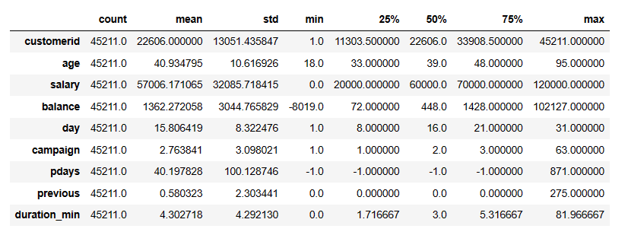
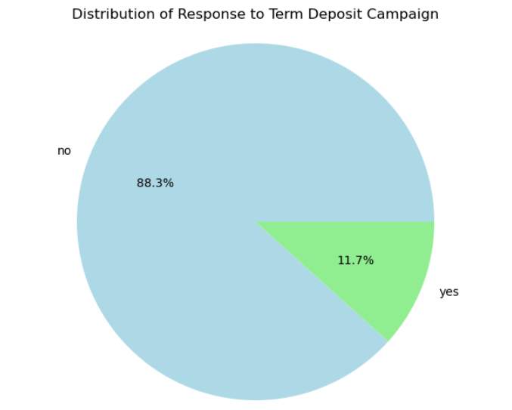
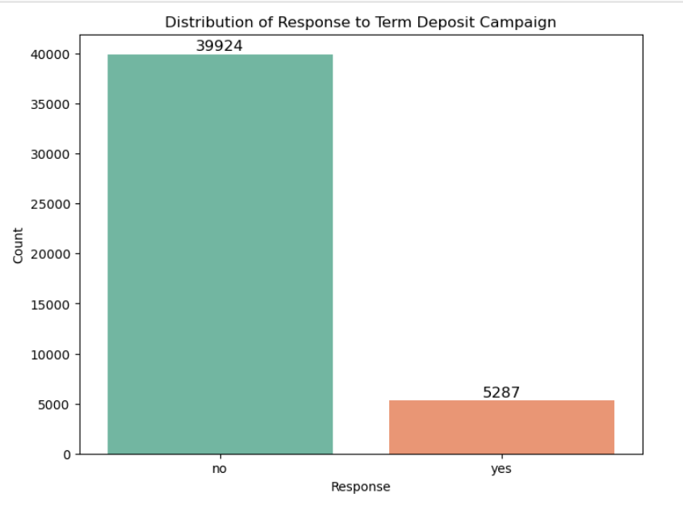
Evaluation and Deployment
2. a) Derive summary statistics (mean, median, standard deviation) for relevant columns.
b) Examine the distribution of the target variable, indicating responses to the term deposit campaign.
Evaluation Phase:
A. The summary statistics provide valuable insights into the distribution and characteristics of the relevant columns, helping us understand the central tendency, variability, and range of the data.
B. The evaluation of the distribution of the target variable, representing responses to the term deposit campaign, is crucial for understanding the balance between positive and negative outcomes.
The pie chart illustrates that the majority of responses are "No," comprising 88.3% of the total responses, while "Yes" responses constitute 11.7%. This analysis provides valuable insights into the overall effectiveness of the campaign in eliciting positive responses from customers.
Deployment Phase:
A. These summary statistics can be utilized to make informed decisions in various stages of the project, such as data preprocessing, feature engineering, and model building.
Understanding that the majority of responses are negative ("No") enables stakeholders to adjust campaign strategies, targeting efforts, or messaging to improve response rates and optimize resource allocation for future campaigns.

Slide 7
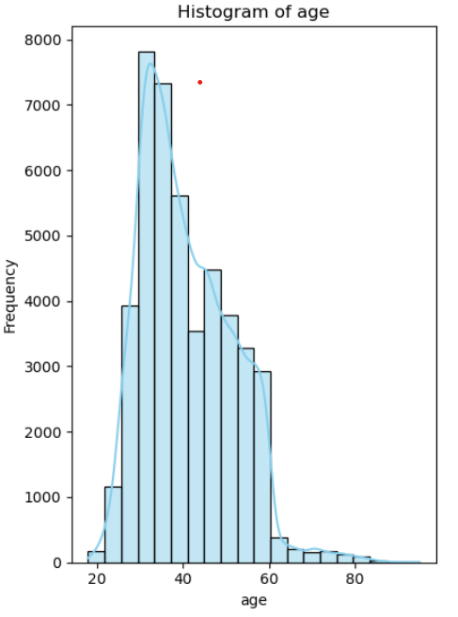
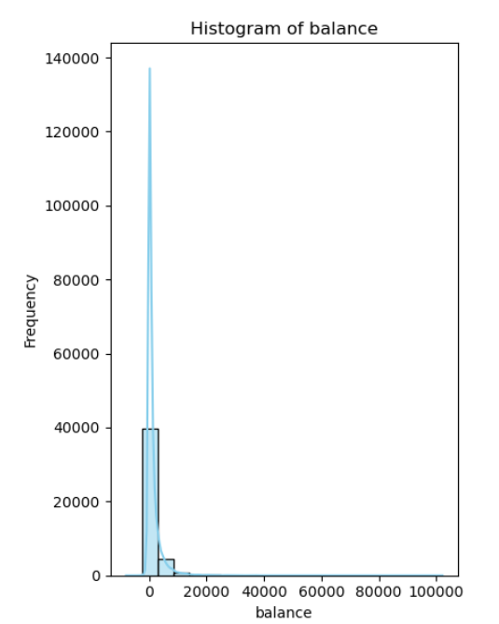
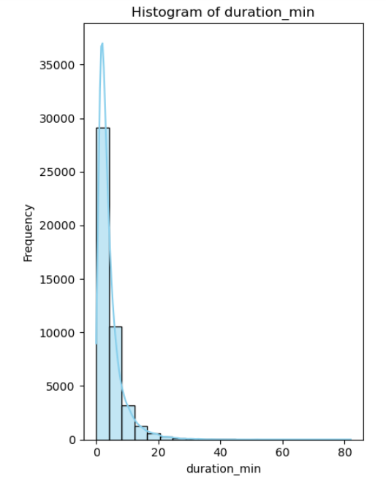
3. a) Examine the distribution of individual key features, such as age, balance, and call duration.
Evaluation Phase:
The histogram depicting the distribution of age reveals a skewed right (positively skewed) shape, with a peak between the ages of 20 and 40, followed by a gradual decline in frequencies towards older ages.
The distribution of account balances exhibits a heavily skewed right (positively skewed) shape, with the majority of account balances concentrated in the lower range (0 to 20,000). This distribution pattern indicates a significant proportion of customers with lower account balances.
The histogram depicting call duration (duration_min) reveals a heavily right-skewed distribution, with the majority of calls being relatively short in duration. This distribution pattern suggests that most calls are short-lived, potentially reflecting quick inquiries or introductory conversations rather than extensive discussions or transactions
Deployment Phase:
The insights derived from the age histogram can inform targeted marketing strategies aimed at specific age groups.
The balance histogram can guide targeted marketing campaigns promoting term deposits or savings accounts may be tailored to appeal to customers with lower balances by highlighting benefits such as competitive interest rates or flexible deposit terms.
Insights from the duration_min histogram can inform strategies for optimizing call center operations and enhancing telemarketing campaign effectiveness.

Slide 8
4.a) Evaluate the relationship between independent variables and the target variable.
Evaluation Phase:
Marital Vs Response - Marital status significantly influences response rates, with married individuals comprising the majority but exhibiting lower response rates compared to unmarried and divorced individuals.
Default Vs Response - The analysis reveals that approximately 11.80% of customers without loan defaults responded positively to the campaign, whereas only around 6.38% of customers who defaulted on loans responded positively.
Housing Vs Response - For The housing column analysis reveals a substantial disparity in response rates between customers with and without housing loans, with customers lacking housing loans exhibiting a notably higher response rate of approximately 9.12%.
Loan vs Response - Customers without personal loans exhibit a higher response rate of approximately 12.67%, while those with personal loans show a lower response rate of around 6.66%.
Contact VS Response - With cellular contacts exhibiting the highest response rate of approximately 14.92%, followed by telephone contacts at 13.43%, and unknown contacts at 4.08%.
Deployment Phase:
For Marital Vs Response - Tailoring marketing strategies based on marital status can optimize campaign targeting, maximizing response rates and campaign effectiveness.
For default, housing, loan Vs Response - Implementing personalized outreach, incentives, or tailored messaging for specific customer segments can boost engagement and response rates, ultimately enhancing the success of the telemarketing campaign.
Contact VS Response - Developing targeted communication strategies based on contact methods can optimize engagement in the telemarketing campaign. Leveraging preferred communication channels, such as phone calls or digital platforms, and tailoring messaging to suit customer preferences can enhance response rates and campaign effectiveness.

Slide 9
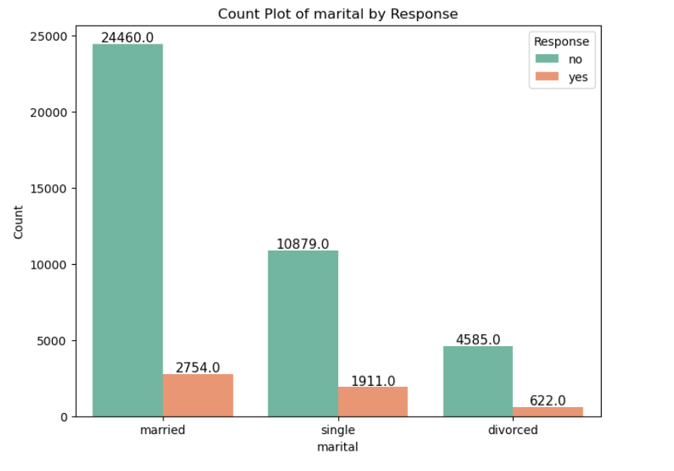
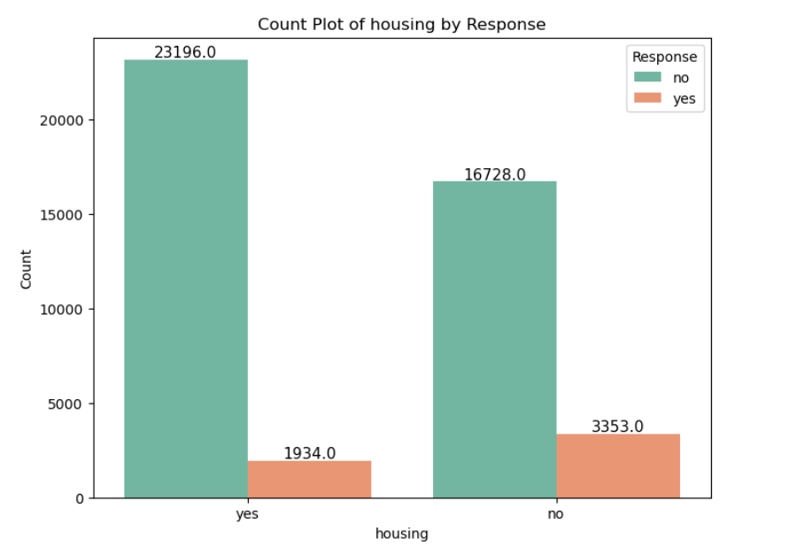
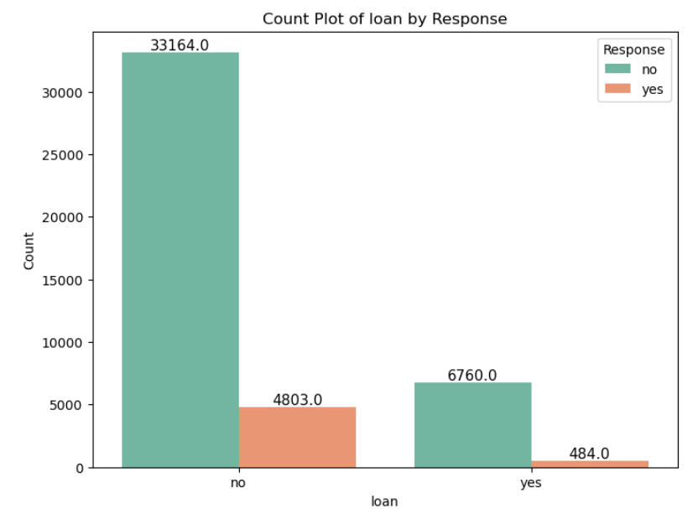
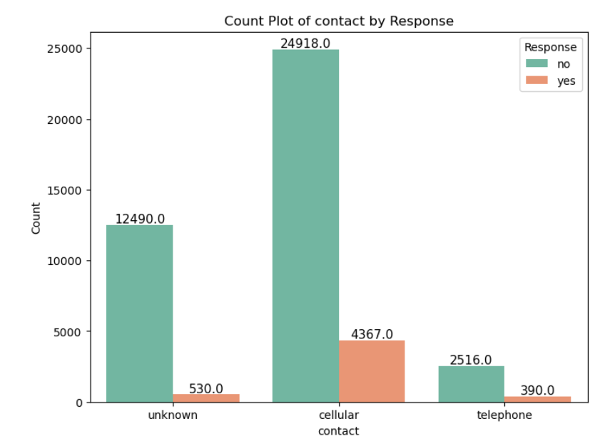
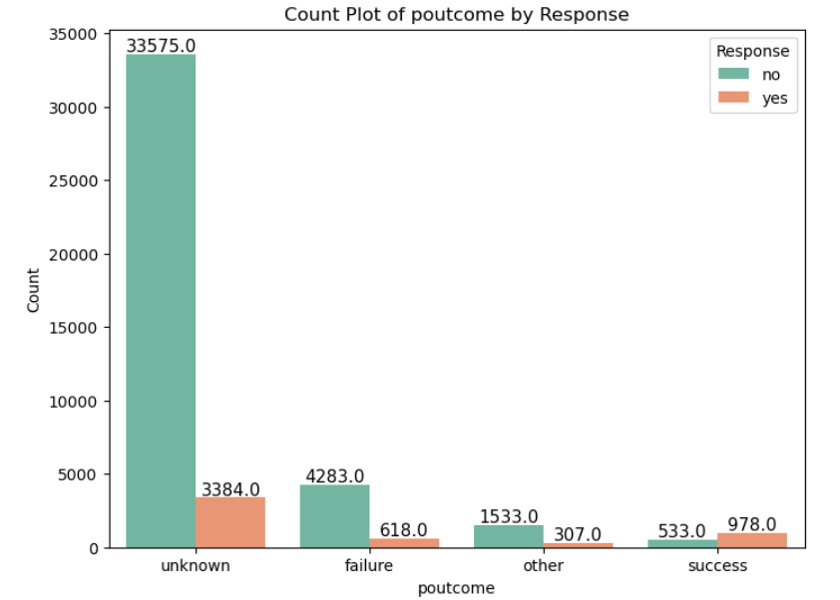
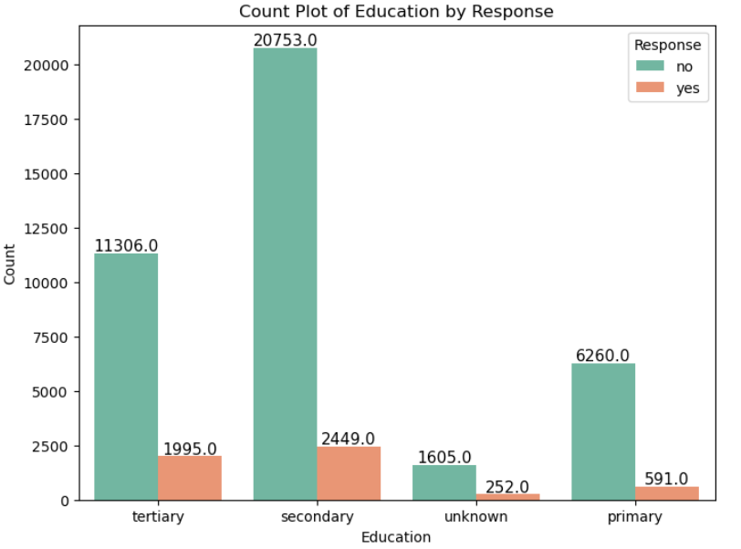
Evaluation Phase:
Poutcome Vs Response - Customers with unknown outcomes exhibit a response rate of approximately 9.16%, while those categorized as failures show a response rate of around 12.58%. Successful outcomes yield a response rate of approximately 64.72%, whereas other outcomes result in a response rate of about 16.67%.
Education vs Response –
Primary vs response rate – 8.62% & out of total yes count is 11.17%.
Secondary vs response rate – 8.98% & out of total yes is 46.32%.
Tertiary vs response rate – 15% & out of total yes is 37.73%.
Unknown vs response rate – 13.57% & out of total yes is 4.77%.
Deployment Phase:
Poutcome Vs Response - Focusing on successful outcomes can leverage the high response rate of approximately 64.72%, while addressing failures may improve engagement among this segment, which exhibits a response rate of around 12.58%. Strategies for unknown outcomes and other responses should aim to enhance engagement and response rates, leveraging the observed response rates of approximately 9.16% and 16.67%.
Education vs Response - Targeting customers with higher education backgrounds may enhance engagement and conversion rates, while personalized approaches may be required for those with lower education levels.

Slide 10
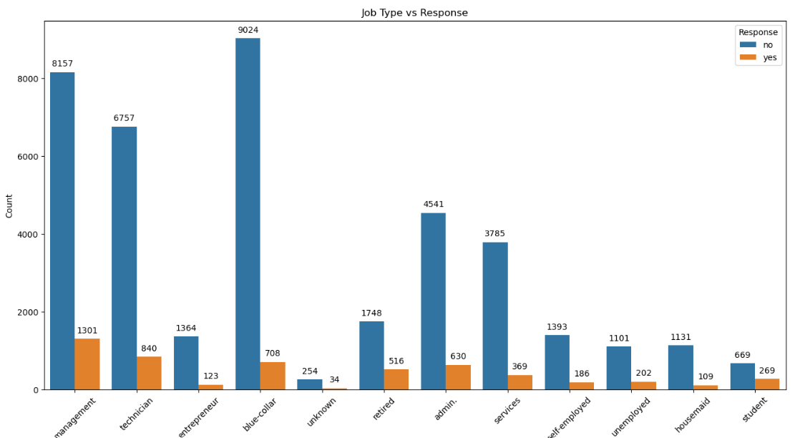
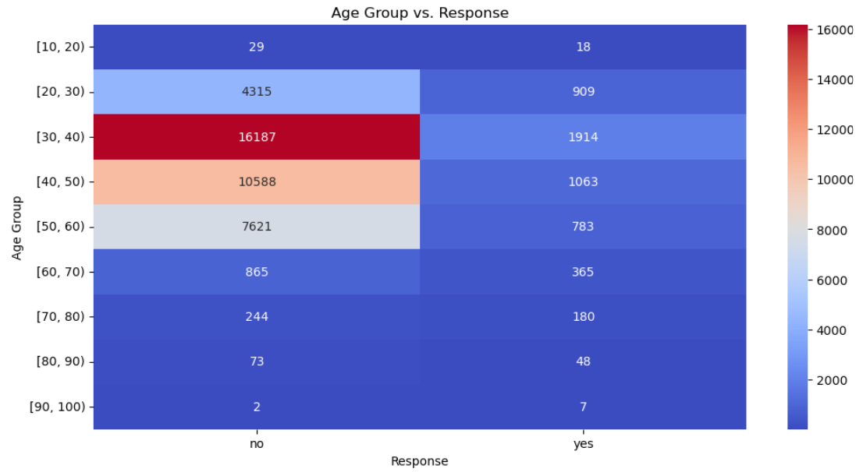
4. b.) Analyze how features like age, job type, education, marital status, etc.,
associate with the success of the term deposit campaign, using visualizations like bar charts, stacked bar charts, and heatmaps.
Evaluation Phase:
Job Type Vs Response Success Ratio - Management and technicians demonstrate relatively higher success rates, with approximately 13.75% and 11.06% positive responses, respectively. Conversely, blue-collar workers exhibit a lower success rate, with only around 7.27% responding positively to the campaign.
Age Vs Response Success Ratio - Notably, while individuals aged 30-40 demonstrate a relatively higher success rate of approximately 10.58%, older age groups, such as those aged 70-80, exhibit a more moderate success rate of approximately 42.5%.
Deployment Phase:
Job Type Vs Response Success Ratio - Utilizing insights from the analysis, targeted marketing initiatives can be deployed to capitalize on professions exhibiting higher response rates.
Age Vs Response Success Ratio - Utilizing insights from the analysis, targeted marketing initiatives can be deployed to capitalize on age demographics exhibiting higher response rates, such as individuals aged 30-40. Additionally, special attention may be warranted for older age groups, where response rates are more moderate.

Slide 11
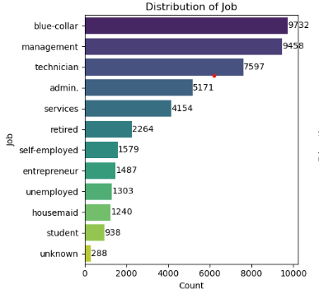
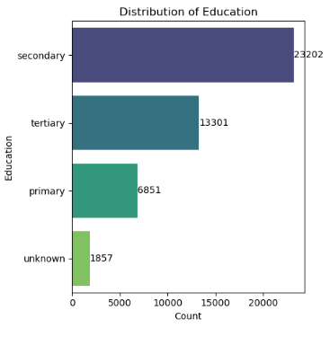
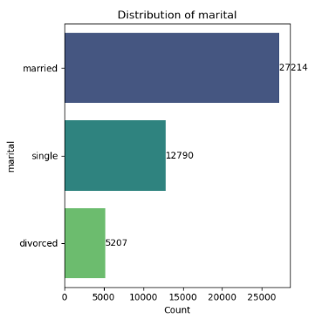
5.a) Investigate the distribution of categorical variables such as job type,
education, and marital status.
Evaluation Phase:
Distribution of Job - Notably, 'blue-collar' and 'management' roles emerge as the most prevalent, with approximately 9,732 and 9,458 occurrences, respectively. Conversely, 'student' and 'unknown' professions exhibit lower frequencies, with approximately 938 and 288 occurrences, respectively.
Distribution of Education - Notably, 'secondary' education emerges as the most prevalent category, followed by 'tertiary', 'primary', and 'unknown.
Distribution of Marital - 'Married' individuals emerge as the most prevalent group, with approximately 27,214 occurrences, followed by 'single' individuals with around 12,790 occurrences, and 'divorced' individuals with approximately 5,207 occurrences.
Deployment Phase:
Distribution of Job - For instance, campaigns may be tailored to resonate with the 'blue-collar' and 'management' segments, leveraging their higher representation for increased engagement and conversion rates.
Distribution of Education - By addressing the preferences and needs of each segment, marketers can optimize campaign effectiveness and achieve broader reach and engagement.
Distribution of Marital - By addressing the preferences, campaigns can be customized to appeal to married couples, singles, and divorced individuals, ensuring inclusivity and maximizing outreach.

Slide 12
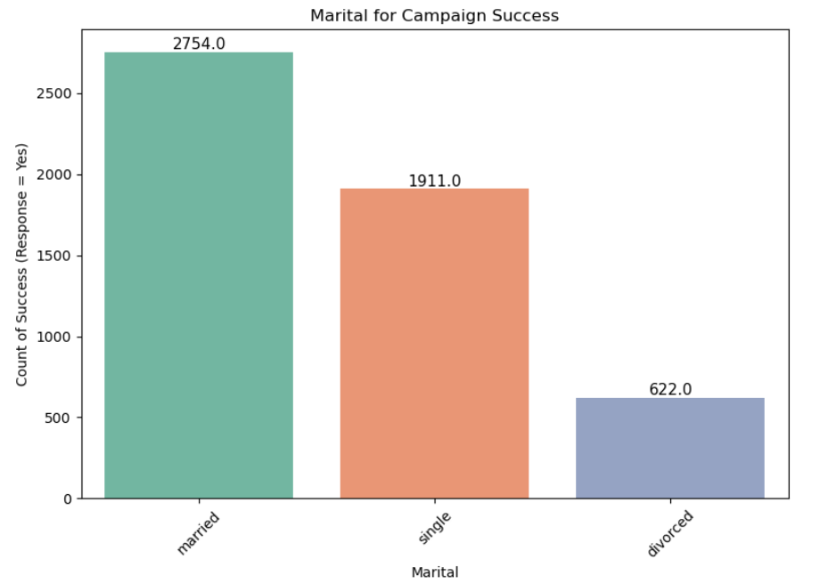
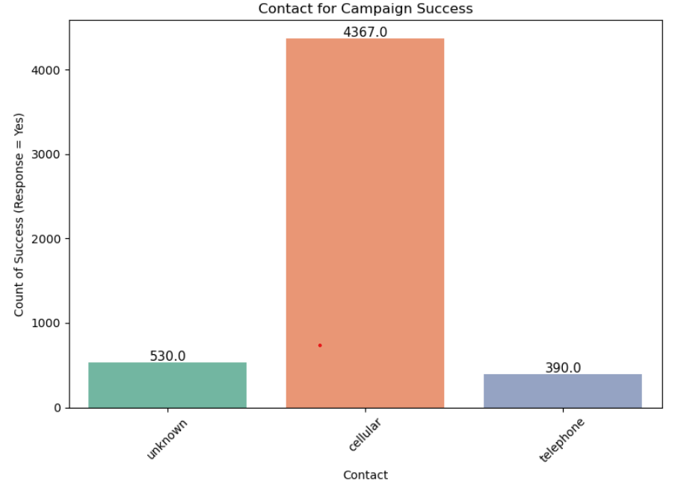
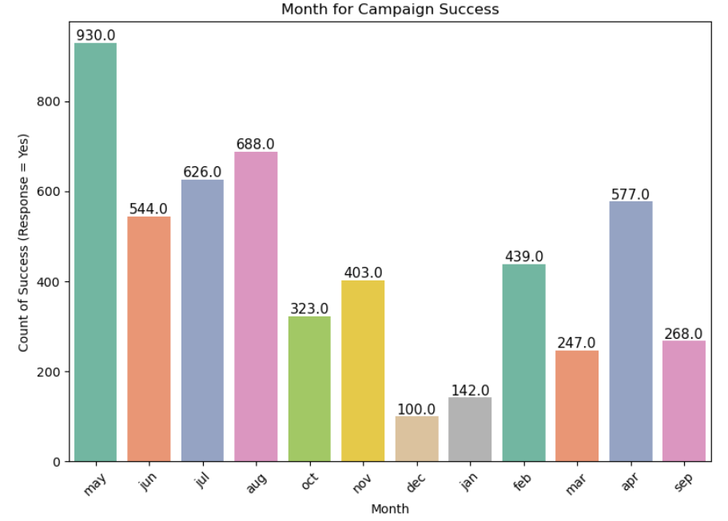
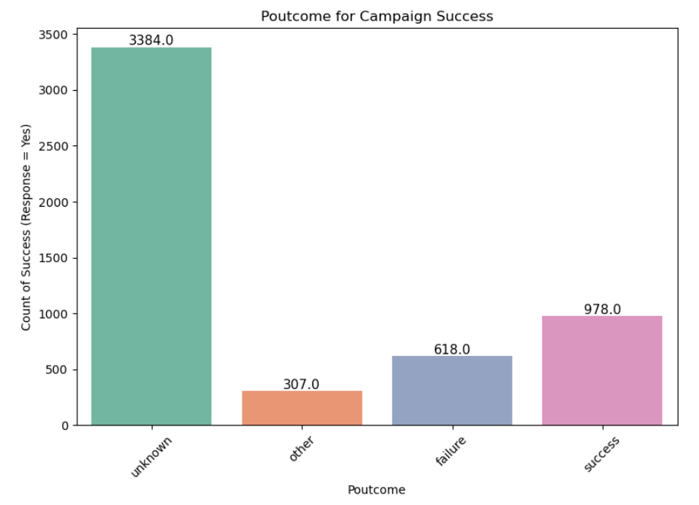
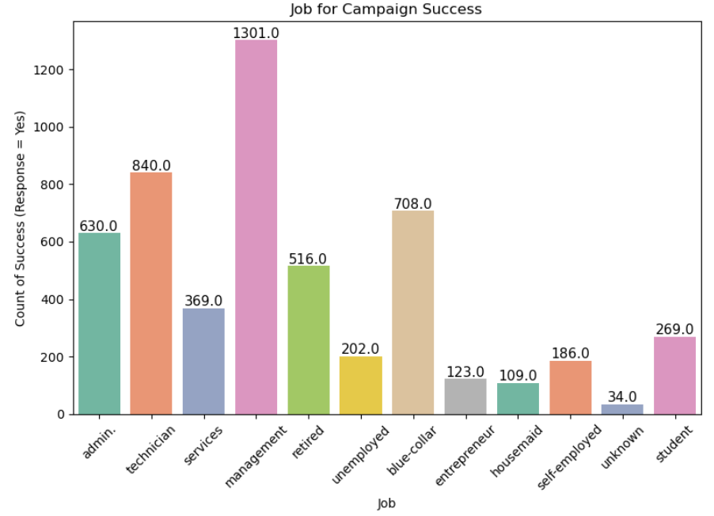
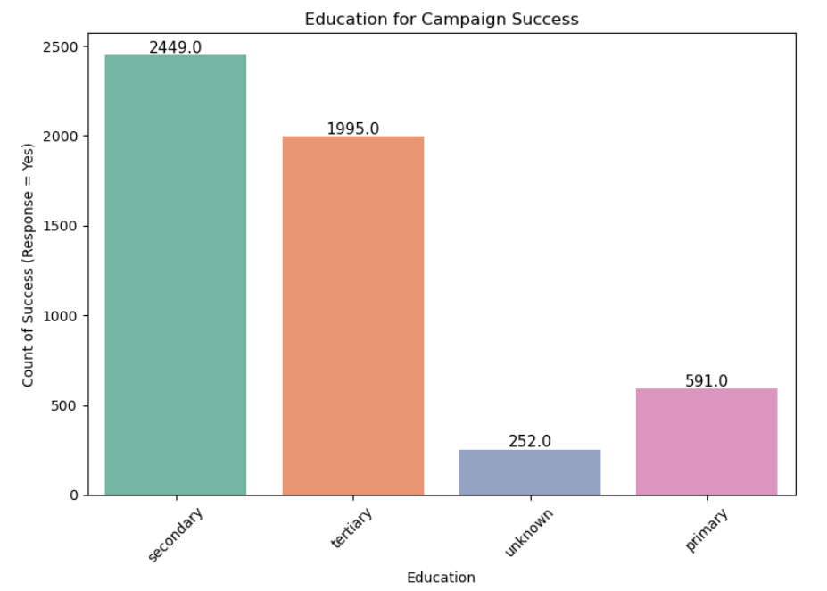
5.b) Assess the impact of these categorical variables on the campaign’s success through visualizations like bar charts.

Slide 13
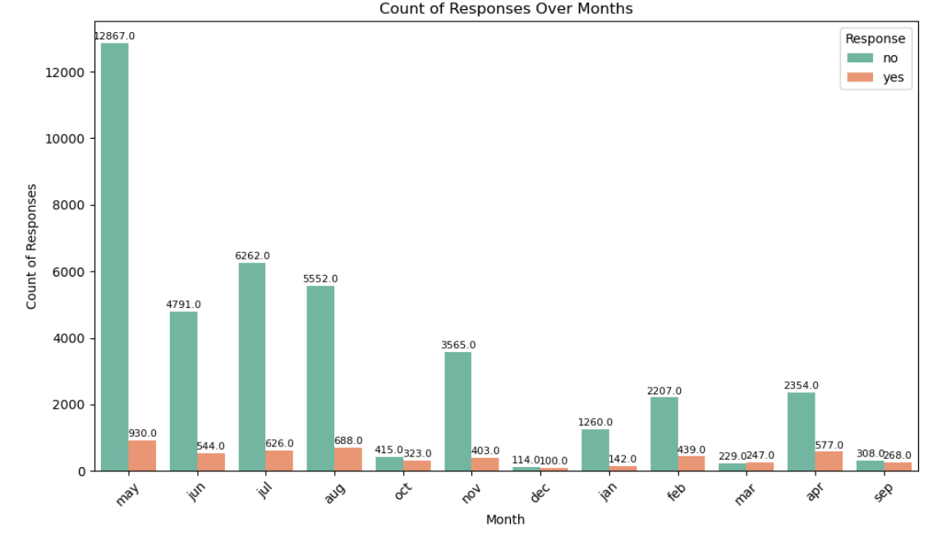
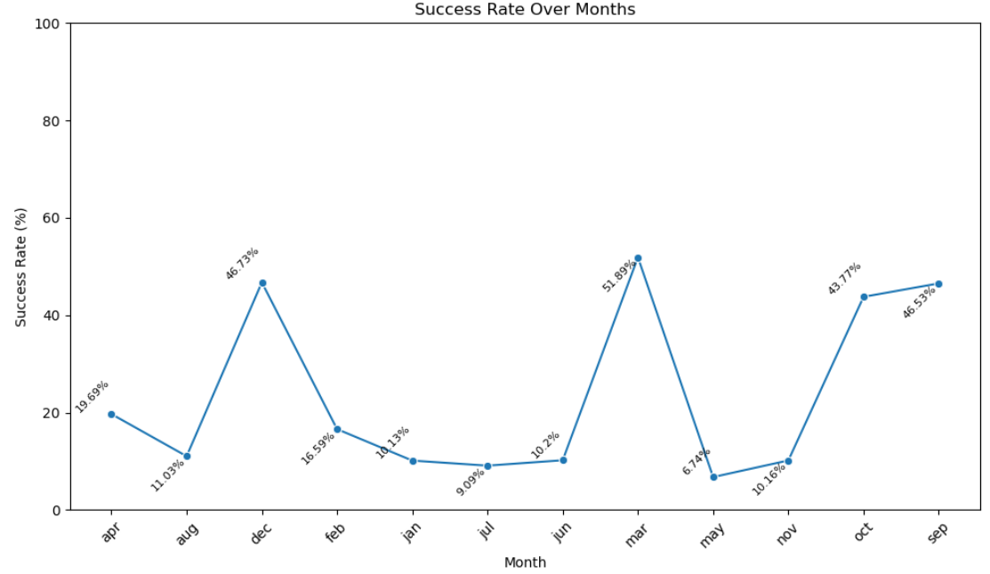
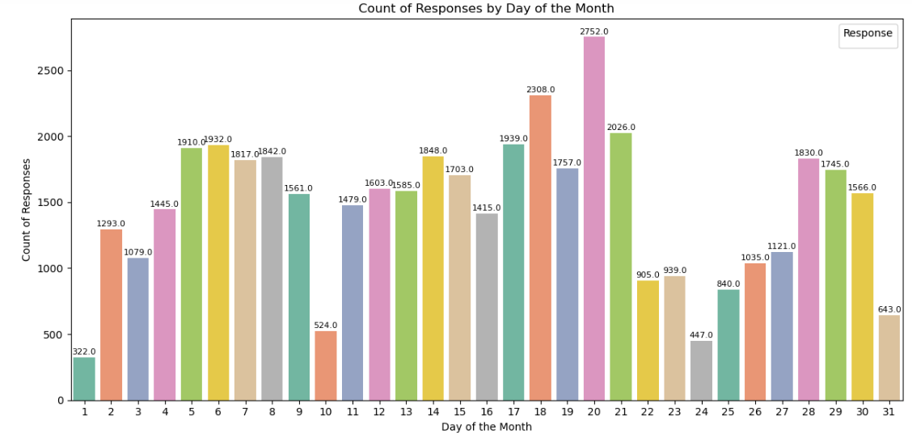
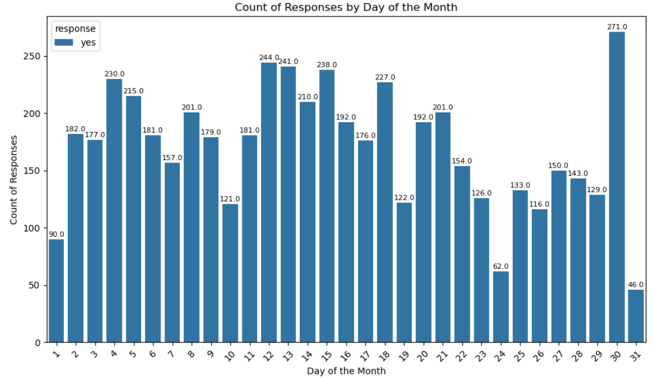
6.a) Investigate temporal patterns in the success of the campaign over time.
b) Analyze if specific months or days exhibit superior campaign performance.

Slide 14
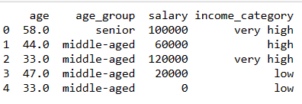
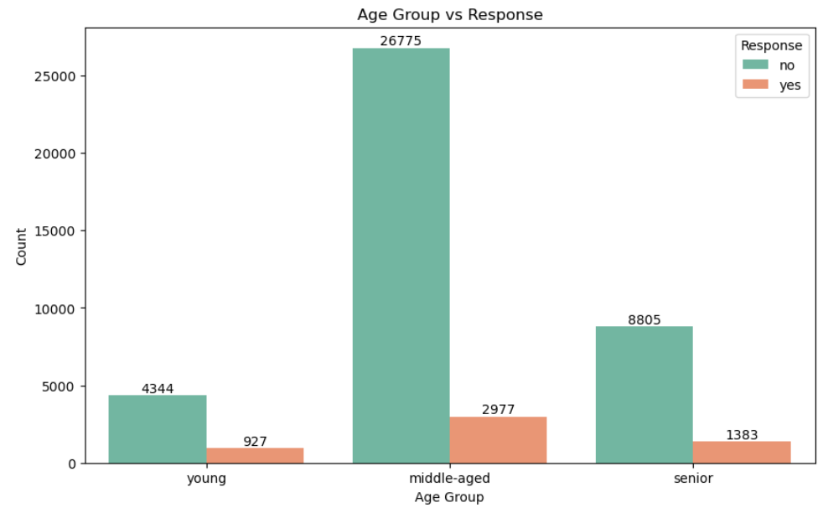
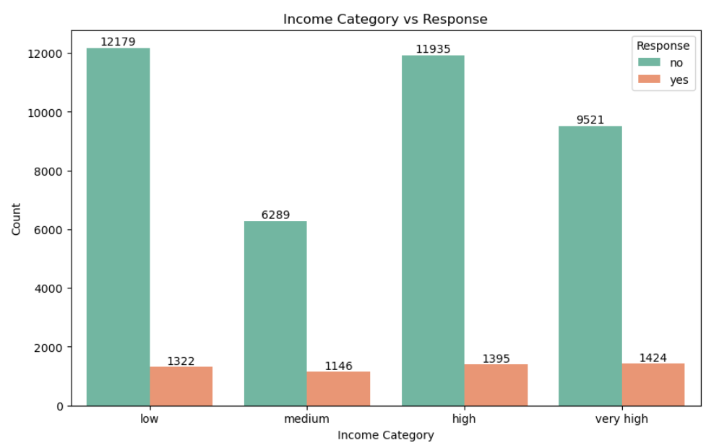
7.a) Introduce new features that may enhance prediction, such as creating a age groups or income categories.
Evaluation Phase:
Introducing new features like age groups and income categories enables us to gain deeper insights into customer demographics and financial status.
Deployment Phase:
By analyzing the response rates across different age groups and income categories, we can identify segments of the population that are more likely to respond positively to the telemarketing campaign for term deposits.

Slide 15
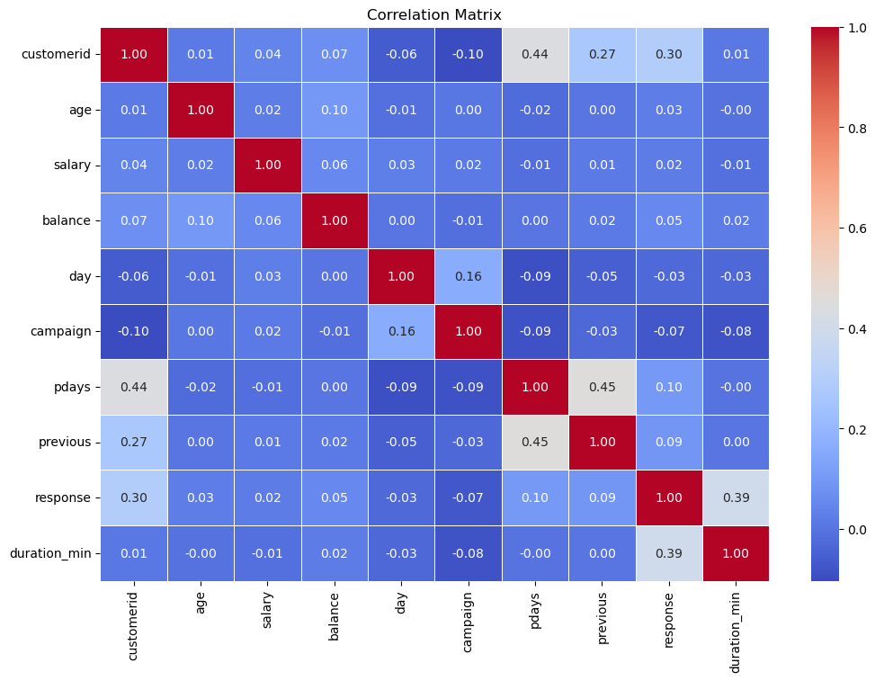
8.a) Investigate the distribution of categorical variables such as job type,
education, and marital status.
Evaluation Phase:
The absence of multicollinearity in the correlation matrix signifies a favorable scenario for our predictive modeling efforts.
Deployment Phase:
From a business perspective, this finding assures us that the features selected for the predictive model are diverse and informative, allowing us to build a robust and reliable model for predicting customer responses to the telemarketing campaign.

Slide 16
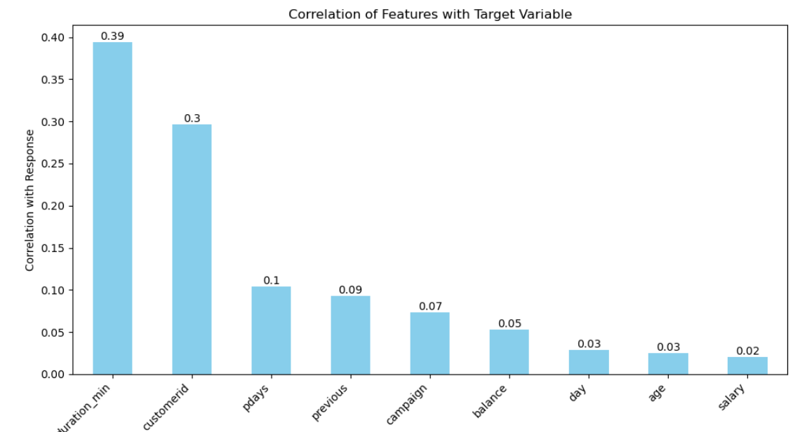
8.b) Evaluate how correlated features may influence the target variable.
Evaluation Phase:
After analyzing the correlation of features with the target variable, it's evident that the duration of the last contact (duration_min) has the highest correlation (0.39) with the response variable, followed by customerid (0.30). This indicates that these features may have a significant influence on the target variable and should be given special attention during model training and evaluation.
Deployment Phase:
By prioritizing features with higher correlations, such as duration_min and customerid, the model can better capture patterns and improve its predictive accuracy when deployed in real-world scenarios.

Slide 17
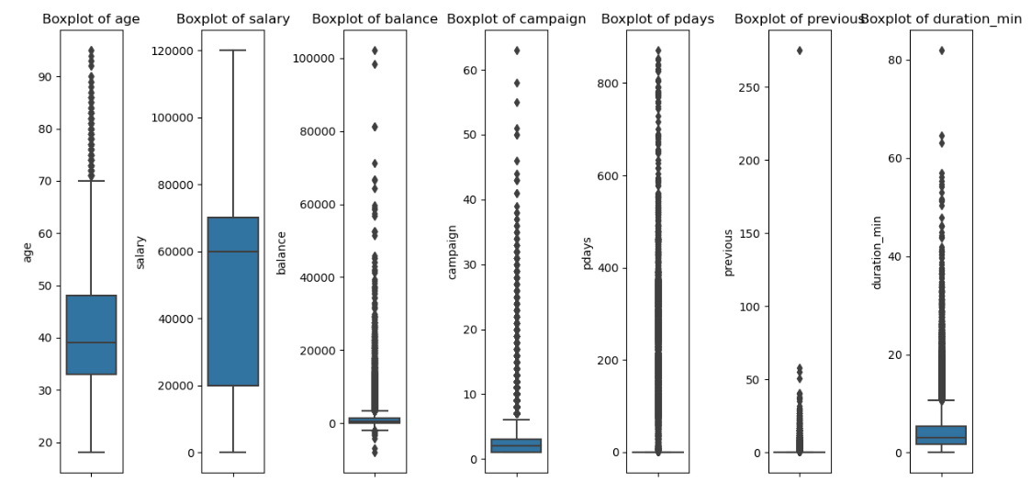
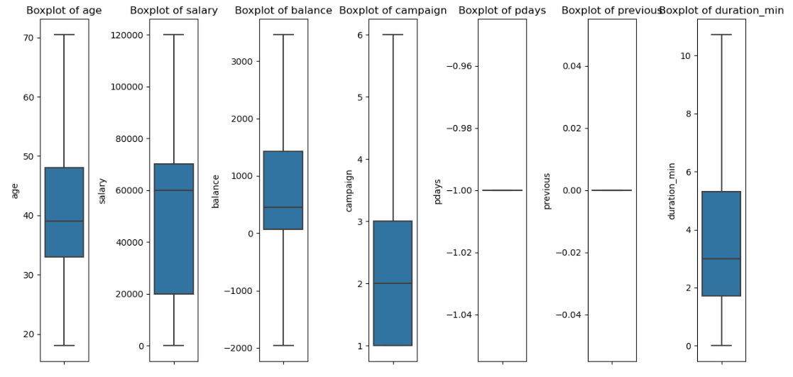
9.a) Identify and rectify outliers that could impact the analysis and predictions.

Slide 18
CONCLUSION
Our analysis of the banking telemarketing campaign revealed several key insights. Through exploratory data analysis, we identified age groups and income categories as influential predictors of campaign success.
We leveraged encoding techniques to prepare categorical variables and examined correlations to address multicollinearity. Notably, the duration of the last contact emerged as the most impactful feature.
By prioritizing these insights in model development and deployment, we aim to enhance predictive accuracy and optimize marketing strategies for term deposit campaigns, ensuring sustainable growth and improved customer engagement.

Slide 19
THANK YOU

